Slide 1
Inspiration Motivation professionalism
planning and monitoring tools at all levels of development

Slide 2
Experience
values
Schools
Community Classes
Club
National Team
Respect
Motivation
Inspiration
Professionalism

Slide 3
Planning
What to plan?
2. How to plan?
3.Why?

Slide 4
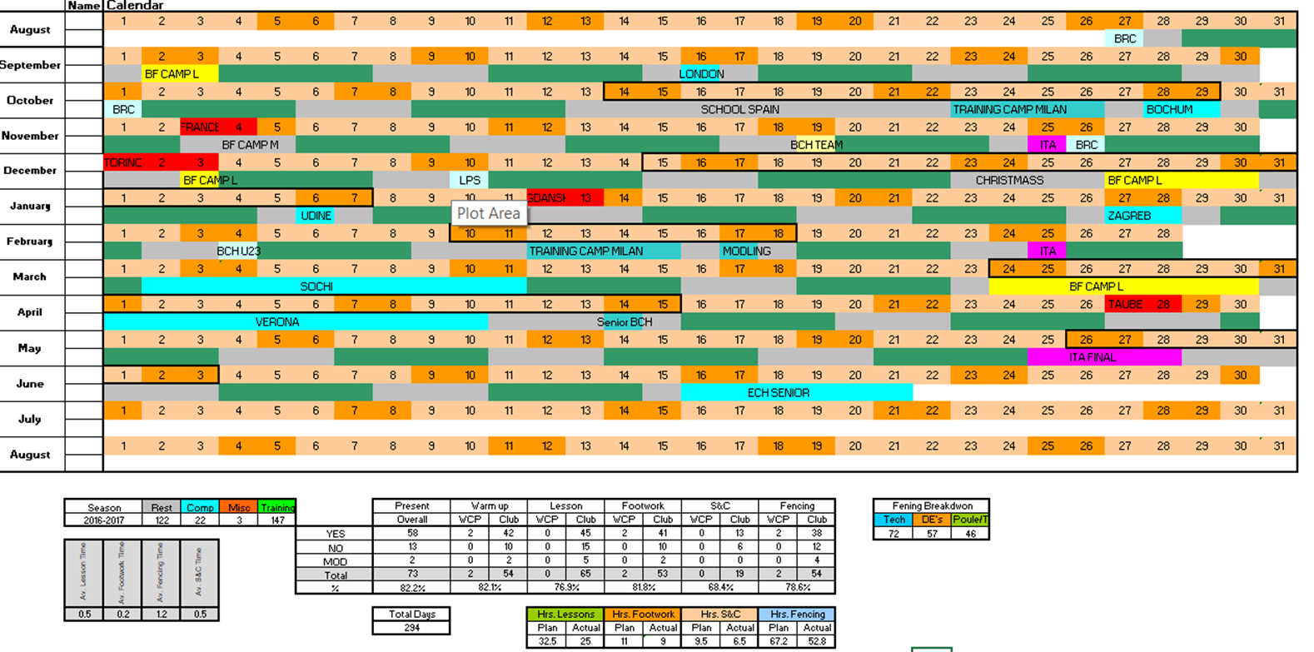
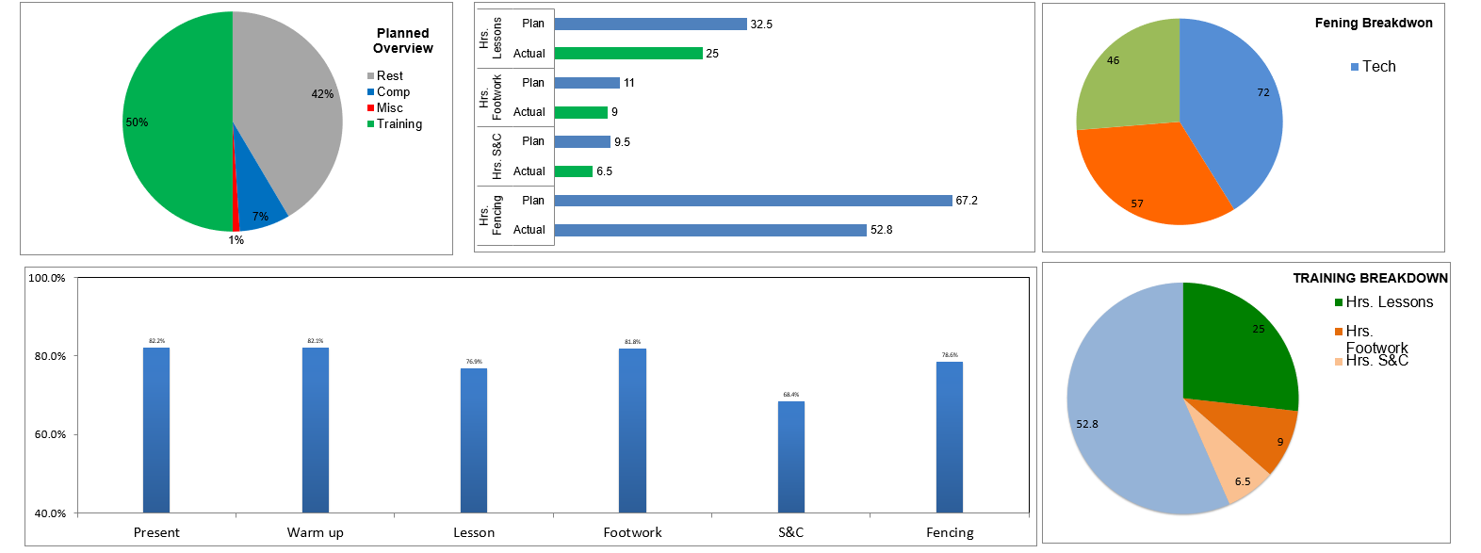
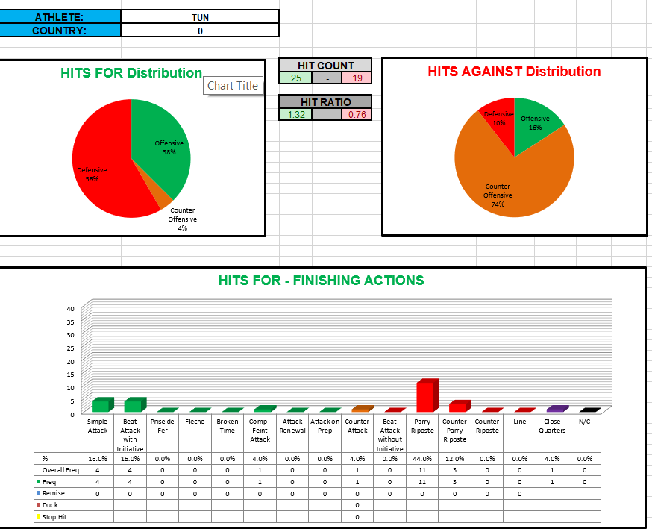

Slide 5
Monitoring tools
Fencers profile and development plans

Slide 6
How do I start?
Complex self monitoring exercise for fencers
Self awareness
Ability to review and reflect own performance
Ability to critically (objectively) judge own performance

Slide 7
What is my role and how I manage this information
Understand the individuals
Understand the team dynamic
Excellent knowledge about the outside environment
Open mind for changes

Slide 8
The biggest mistake in life
Is not to make any

Slide 9
Thank you for your attention and engagement
Start the change today
The success is somewhere there to achieve

Slide 10
